Slide 1

Pop Music Culture Spotify Data Analysis
By Alex Vo, Joshua Villasuso, & Aaron Rios

Slide 2
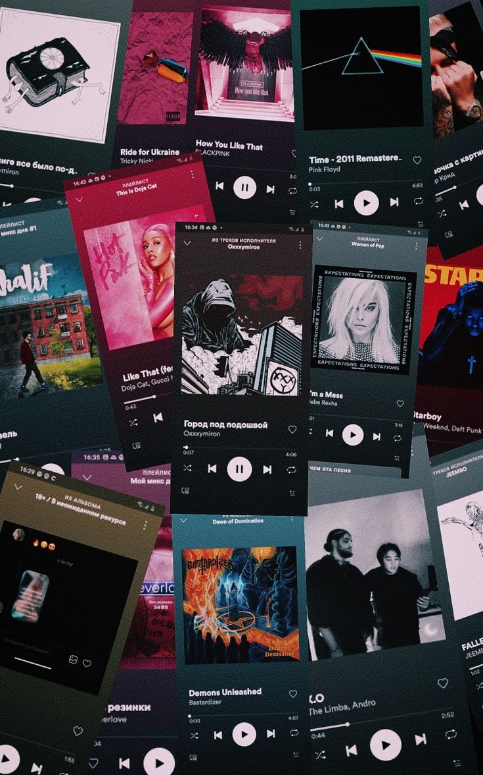
Introduction
In this project, we will be analyzing pop tracks from only one artist to two music artists and the years ranging from today to 1930.
Our team is exploring each track and discover the different music subgenres that fit under the pop music umbrella.
Data is analyzed by track name, number of streams, music brand playlists and charts from Apple, Deezer, Shazam, and Spotify.
Tracks in the Spotify file can also be analyzed based on the amount of energy, danceability, instrumentalness, and speechness.
Our topic question: How does pop music build different music subgenres such as hip-hop and indie which helps bring the music industry?

Slide 3
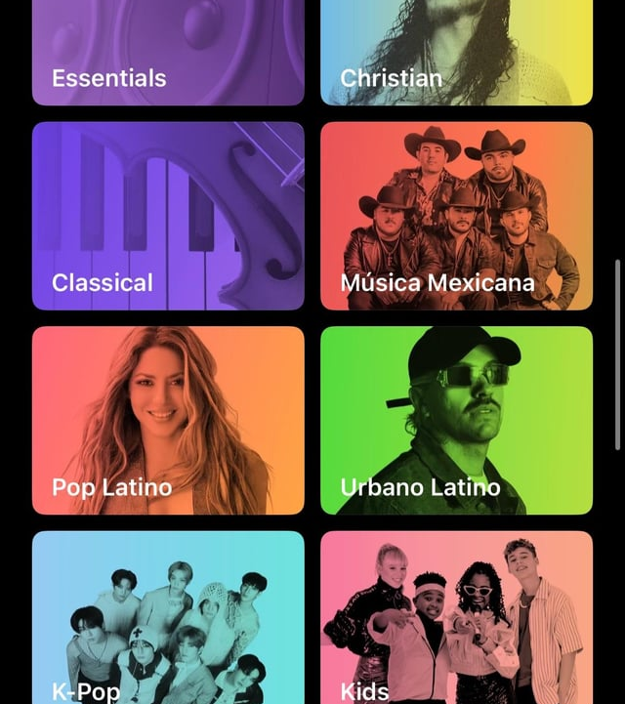
Methodology
We analyzed the tree map built on Tableau based on discovering the greatest number of streams for each pop music song.
We created a calculated field based on the sum of streams and the count of each track.
We developed a music chart analysis to filter out each artist that is mostly or least streamed in music charts such as Apple Music, Deezer, Shazam, and Spotify.
We cleaned up the Excel by finding missing cells in each columns from Excel, determine the structure of our data, trim out letter characters from left, remove any potential duplicates, and more.

Slide 4
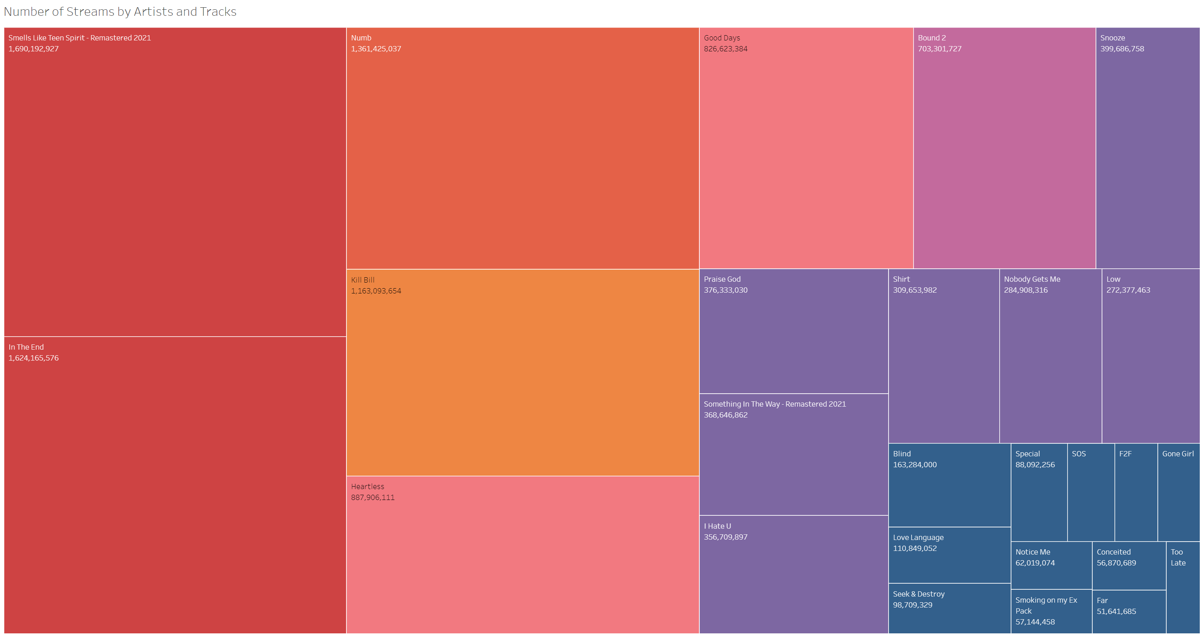
Tree map Analysis
As you can see here:
the most listened to track on Spotify was Smells Like Teen Spirit – Remastered 2021, with a total of 1,690,192,927 streams.
The least listened to track on spotify was Too Late, with a total of 49,262,961
Pop music is used in social media posts in many ways, including promoting music, connecting with fans, sharing music, influencing social media, and creating a subgenre.

Slide 5
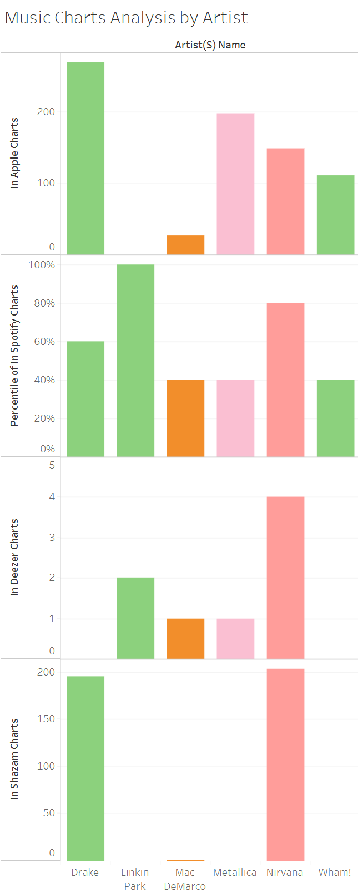
Bar chart analysis
While filtering out the six artists, Drake, Linkin Park, Mac DeMarco, Metallica, Nirvana, and Wham! by the Shazam, Deezer, Spotify, Apple Charts, you can see that in Shazam Charts in specific, Drake and Nirvana were dominating the other artists.
You can also see that Drake and Nirvana were dominating half of the four charts, except for Spotify and Deezer.
From the Spotify charts, the only band that was dominating is Linkin Park.
Nirvana’s chart performance is at their peak in all of the charts, unlike Wham!’s chart having a downfall by their cult following.

Slide 6
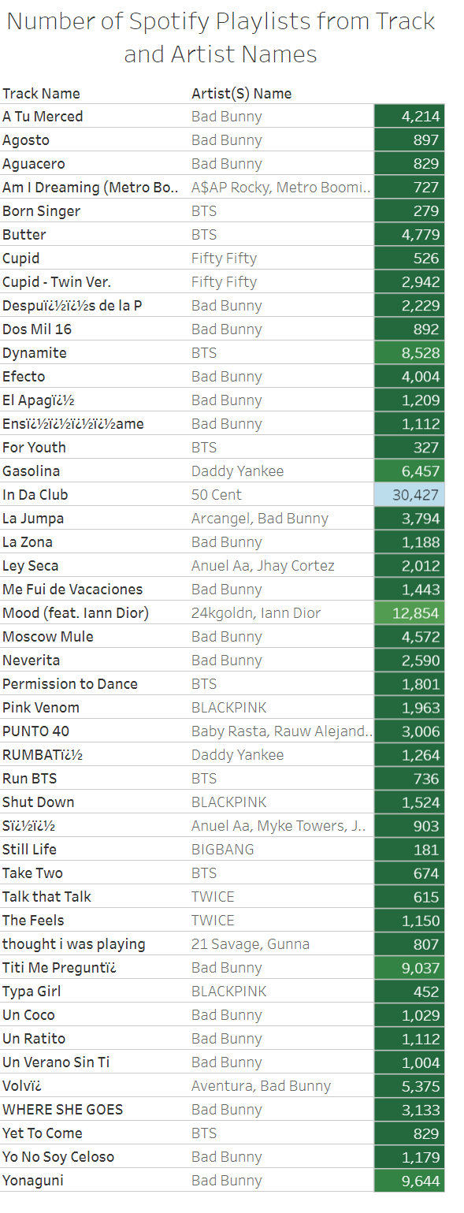
Text table analysis
While filtering out artists such as Bad Bunny and BLACKPINK from pop music genres such as K-pop and Latino rap, I noticed that Bad Bunny is the artist that have most of their songs saved in most Spotify playlists.
BIGBANG is the artist with the least number of Spotify playlists with the number 181.
BTS’s song Dynamite in the K-pop music subgenre has their song saved on most Spotify playlists with the number 8,528.
The text table includes a calculated field made with Tableau to calculate the SUM number of streams plus the COUNT of track names.

Slide 7


Conclusion
Rap, R & B, and alternative rock are the most streamed music subgenres under the pop music umbrella based on the tree map.
The Spotify, Shazam, and Deezer charts tells that rock is ranked the music subgenre that is mostly listened by pop music fans based on the filtered artists.
When songs are mostly streamed in all music brands like Spotify and Apple Music, it brings an algorithm in the app to recommend all kinds of similar songs that fits the energy, danceability, and the vibe from the song being previously played.
Another result to share is that when a song is being repeated on apps like Spotify or Apple Music, it collects the user's data and builds an end of the year music review that dives in on what users enjoy to listen when they open the music app and the top music genres or subgenres that are mostly listened.

Slide 8
References:
Pequeño, Antonio, IV. “Spotify Wrapped: Here’s How Spotify Calculates Your Listening Data.” Forbes, 9 May 2024, www.forbes.com/sites/antoniopequenoiv/2023/11/29/spotify-wrapped-heres-how-spotify-calculates-your-listening-data.
Sanders, Chaise. “I Tested Apple Music Vs. Spotify, and I Have Thoughts on Which Is *Actually* Better.” Cosmopolitan, 4 Sept. 2024, www.cosmopolitan.com/about/a61947850/apple-music-vs-spotify.

